Slide 1

The Dark Sector of the Universe and the BINGO/ABDUS project.
I present the observational and theoretical developments concerning the cosmological structure since the Discovery of a Dark Sector comprising the overwhelming majority of cosmological matter constituents.
I especially argue in favour of the construction of the BINGO (BAO from Integrated Neutral Gas Observations) observatory, which is being supported by a consortium led by Brazil and China and its second phase, with high resolution, the ABDUS Project, Advanced Bingo Dark Universe Studies.
Elcio Abdalla
China 2024

Slide 2
Team
Management: Elcio Abdalla, A. Queiroz, Bin Wang, F. Abdalla, A. Wuensche, Chang Feng, Jiajun Zhang
Builders: JiaJun Zhang, Chang Feng, Ricardo Landim, Alessandro Marins, Edmar Gurjão
Members (USP): Jordany Vieira de Melo, Pablo Motta, Gabriel Hoerning, Eveling Costa and others.
Other members: UFCG, INPE and others (Brazil), China (many Universities and companies), France, UK, Italy.
Total: more than 80 members + non scientific staff

Slide 3
Support
FAPESP
Paraiba Government
FINEP
MCTI
Chinese Government
Others

Slide 4
Open Problems in the study of the cosmos
What is Dark Energy
What is Dark Matter
Gravity in Cosmology
Fast Radio Bursts
Pulsars

Slide 5
The Dark Matter Question: brief history
Speculations about Dark, unknown Matter exist since XIX century (see wikipedia)
The first real indication came with Zwicky, 1933, observing the Coma Cluster. In spite of the wrong used value of the Hubble constant this was the first real indication of Dark Matter
Further observations of Galaxy rotation curves little by little confirm the Dark Matter existence

Slide 6
The Dark Matter Question: establishing facts
Further observations in Green Bank and Jodrel Bank in the 70´s
Large Scale structure observations.
CMB observations (more later).
Today: Further observations from lensing, cosmological parameters fixing via precision observations
Distant Supernovae (more about that for Dark Energy)
Redshift Space Distortion
Baryon Acoustic Oscillations

Slide 7
The Dark Matter Question: conclusion
Dark Matter is a reality
It roughly corresponds to 27% of the energy budget of the Universe.
Interaction with visible matter is either inexistente (except for gravity) or very weak

Slide 8
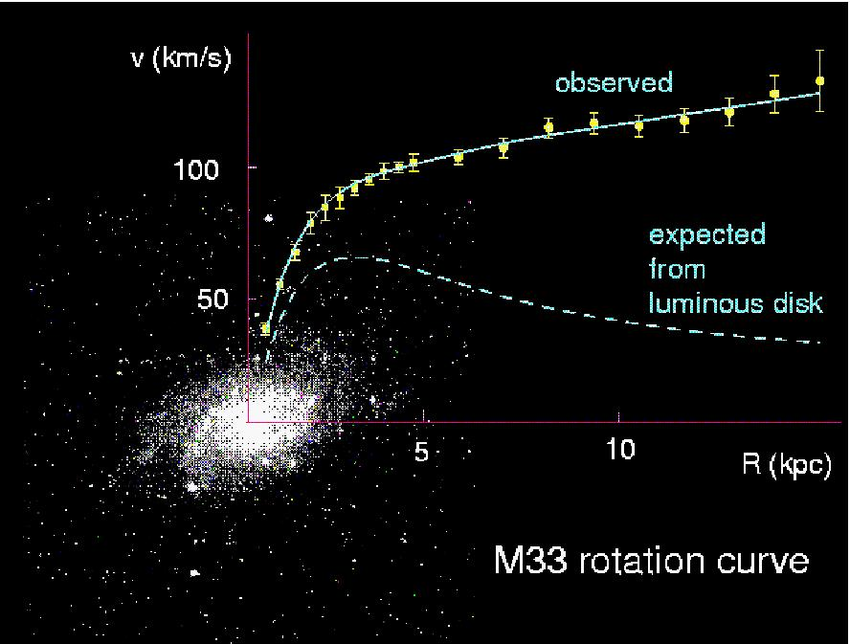
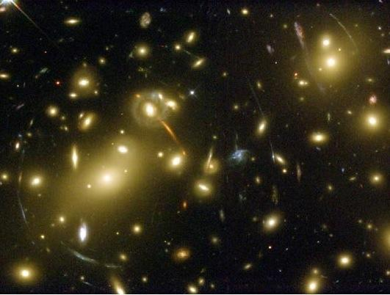
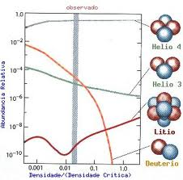
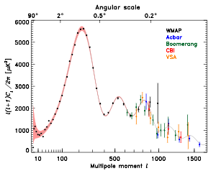
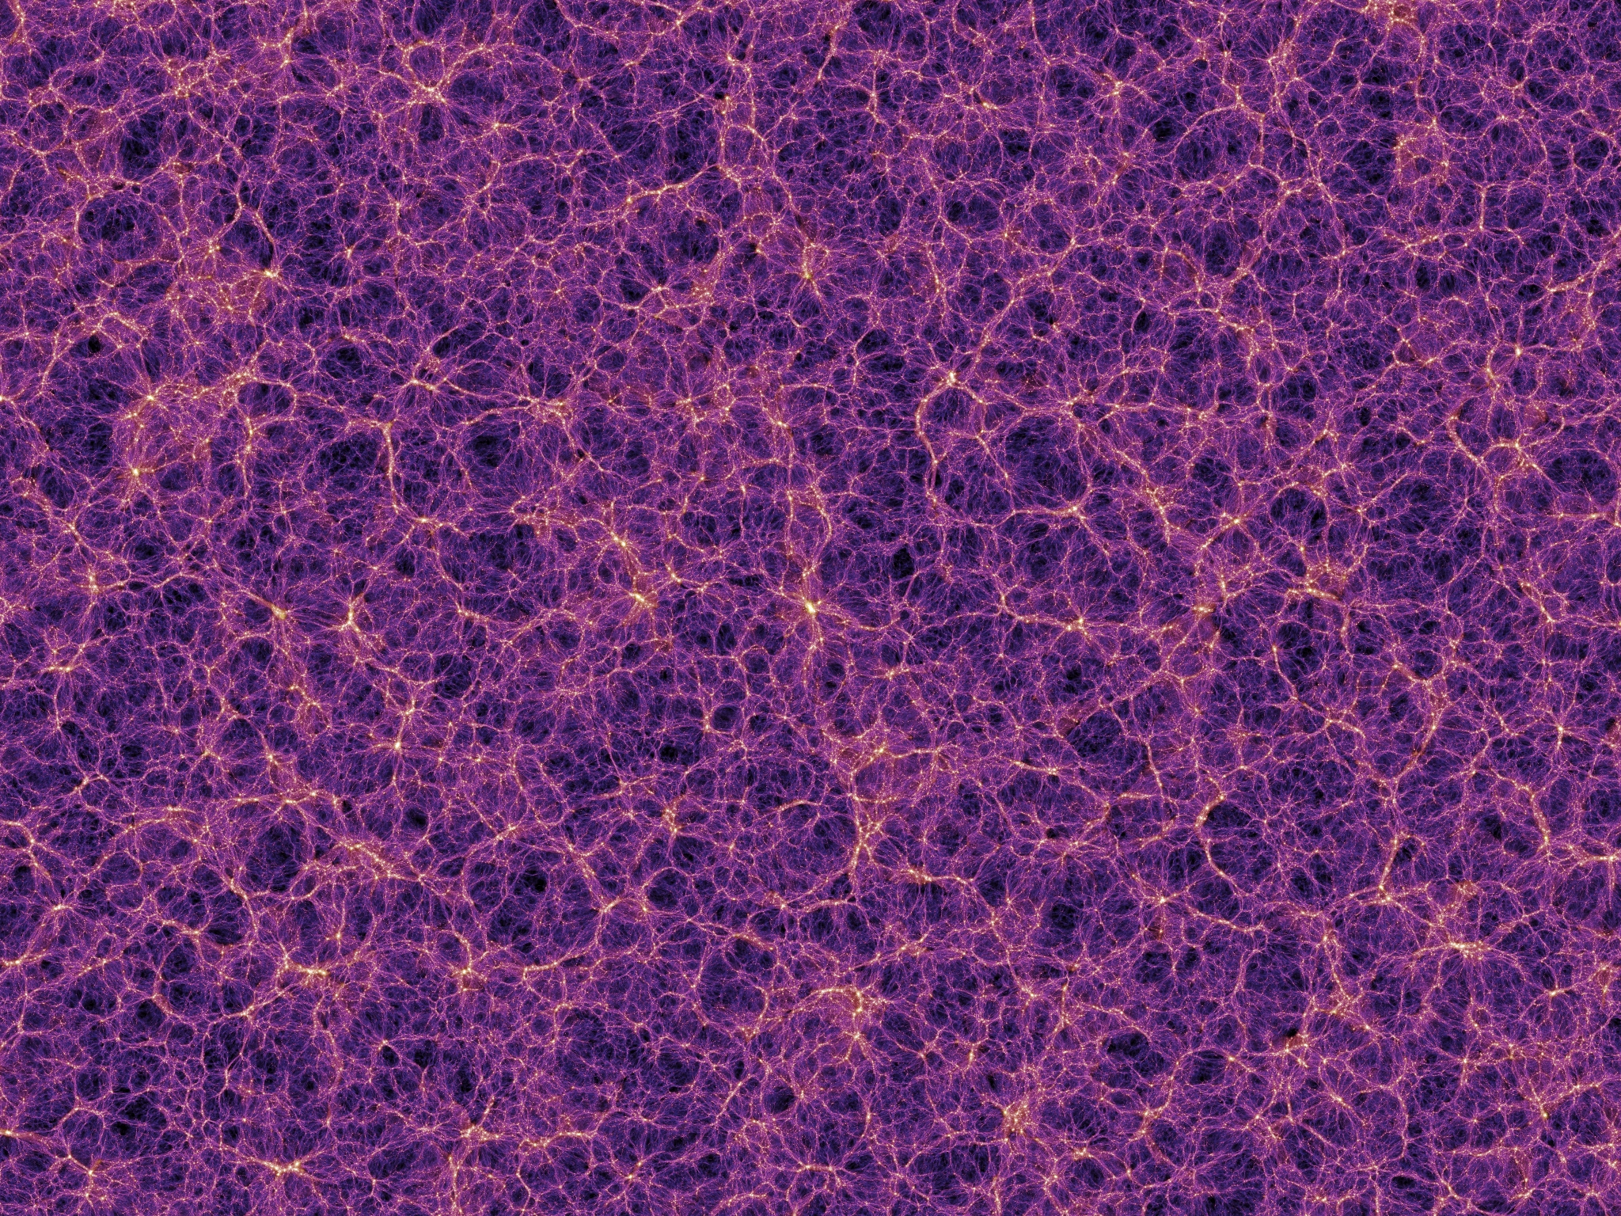
What is Dark Matter?
Evidences for Dark Matter
Huge amount of evidences
indicating that dark matter
exists. One of the biggest
unsolved, but very well measured,
problems in physics.
Observations indicate that DM
interacts mainly gravitationally.
So far, we have no
(non-contradictory) observations
that DM was detected by any
non-gravitational mechanism.

Slide 9
Candidates
Neutralinos (higgsino, binos, winos, singlinos)
Axinos
Gravitinos
Sneutrinos
Axions
Sterile neutrinos
4th generation neutrinos
Kaluza-Klein photons
Kaluza-Klein gravitons
Brane world dark matter/D-matter
Little higgs dark matter
Light scalars
Superheavy states (ie. “WIMPzillas”)
Self-interacting dark matter
Super-WIMPs
Asymmetric dark matter
Q-balls (and other topological states)
CHAMPs (charged massive particles)
Cryptons, …
Supersymetric

Slide 10











































The Flatness problem and a Dark Sector
Friedmann Equation:

Slide 11
The Flatness problem and a Dark Sector
Therefore, k=0 (critical density) is highly unstable!!!
Critical density near 1 now means near 1 around nucleosynthesis with 20 digits certainty!!!
Thus better we have critical density as a result of inflation.
All contributions should add up to the critical density!
Dark Matter + Visible Matter (Baryons) +
[something else](Dark Energy) = critical mass!

Slide 12
The Dark Energy Question
Type 1A Supernovae observation and use of Hubble relation imply that the Universe is in accelerated expansion!!!
A model for the expansion is a cosmological constant, positive, equivalent to a mass density of the order of 69% of the critical mass
Together with previous figures, the Universe is flat.
This constitutes the ΛCDM Standard Model, or Concordance model of Cosmology

Slide 13
The Cosmological Question
The ΛCDM Standard Model is flat, contains Dark Matter (27%), 4% Baryonic Matter (including “minorities”). And today´s data are almost well described
Nothing can describe the Cosmological constant, whose size, compared to Elementary Particle Standard Model is 120 times smaller. Weinberg pointed that out long ago and it constitutes the Cosmological Constant problem

Slide 14
The Cosmological Question
Moreover, Dark Matter and Dark Energy are of the same order of magnitude today, although DE is constant and DM decays with the cube of the scale fator.
This is known as the coincidence problem
Together with the fact that as for today the Dark Sector does not communicate (except for gravity) with the visible Sector, we are in a position of total lack of knowledge about circa 95% of the matter contente of the Universe

Slide 15
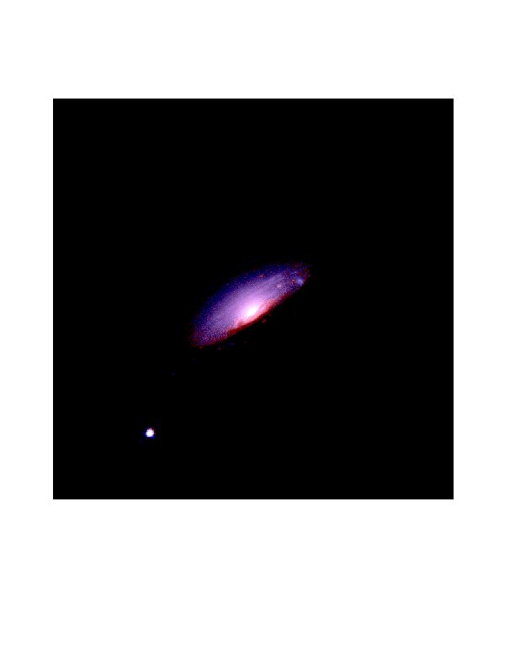
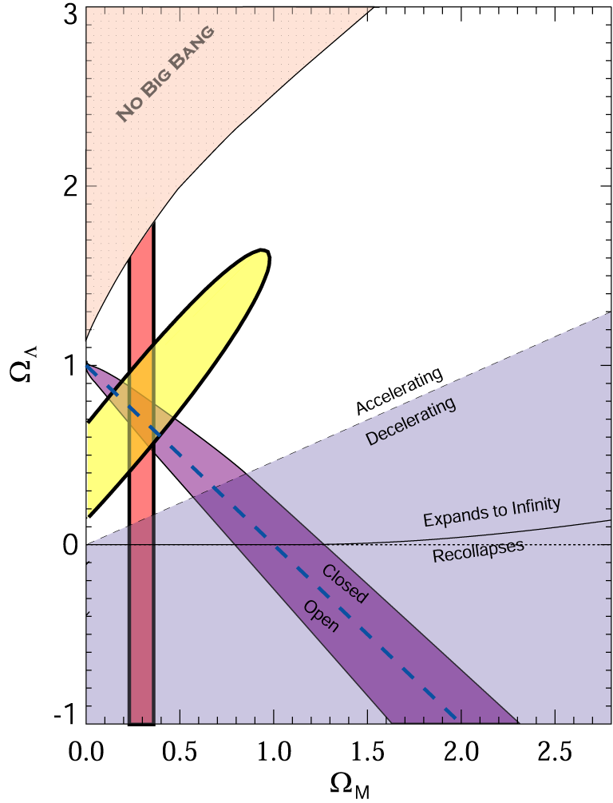
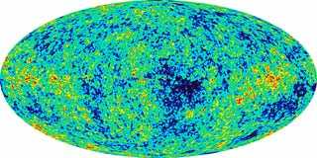
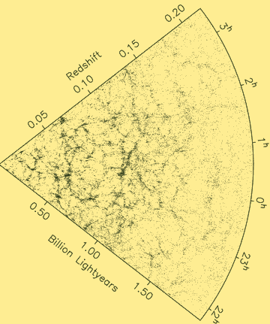
What is Dark Energy?
The Evidence:
98's: The universe is expanding in an accelerated way.
CMB
SNe Ia
Ω_{DE}=0.721±0.025 (WMAP)
WMAP
LSS
Ω_{DE}=0.685±0.013 (Planck)
Source: S. Tsujikawa, “Dark Energy and Modified Gravity"

Slide 16
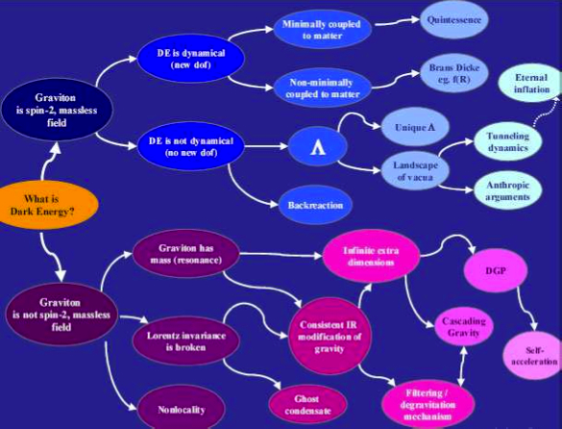
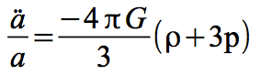
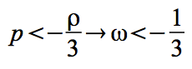
What is causing the acceleration?
Source: de Rahm & Tolley, 2008

Slide 17
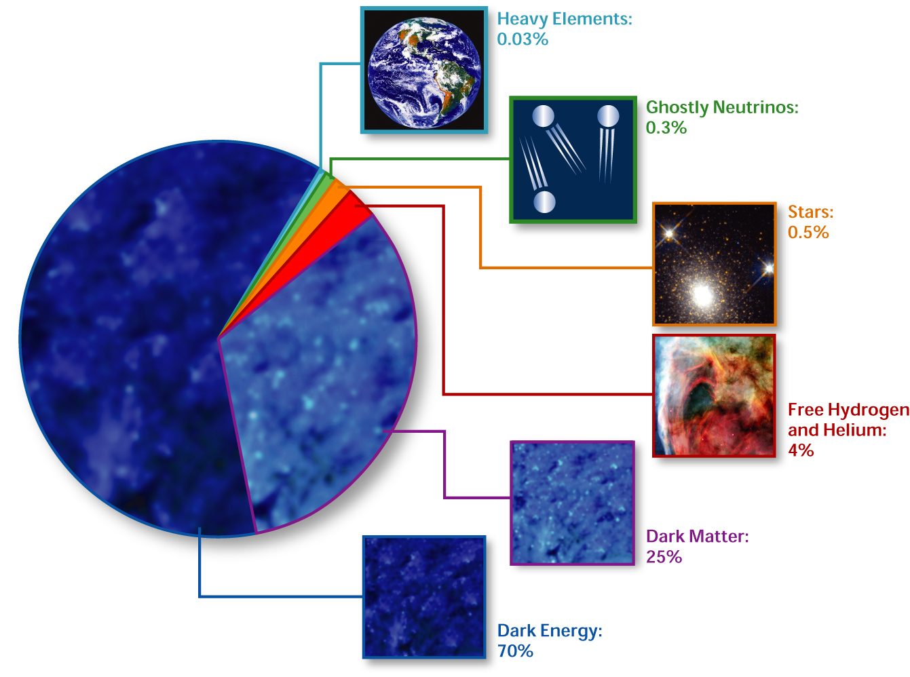
Standard Cosmological Model Composition of the Universe
Elcio Abdalla-Interacting Dark Energy
http://en.wikipedia.org/wiki/Image:Cosmological_composition.jpg source and rights]

Slide 18
The Dark Sector Structure
There is no established model for the Dark Sector based on Field Theory
Dark Matter, up to now, is seen as inert matter, na inert transparente liquid oblivious to touch (no electromagnetism)
Dark Energy is just a cosmological constant.

Slide 19
Precision Cosmology
That is, Einstein Equation is perturbed, we also use Boltzmann Equation to describe the perturbed fluids in interaction and the perturbed field equations. All become linear and can be solved by sophisticated numerical methods.
We compute correlators in the sky also called
1. power spectrum (two point correlators
2. Bispectrum (three point correlators)
3. We obtain temperature variations in the sky

Slide 20
Precision Cosmology
Observing Sky Radiation we have results with high precision, the
Precision Cosmology

Slide 21
Whispers of the Universe: the BINGO project
The ABDUS Project

Slide 22
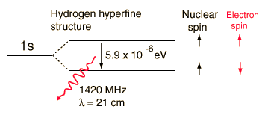
21 cm Physics – The Hyperfine Structure

Slide 23
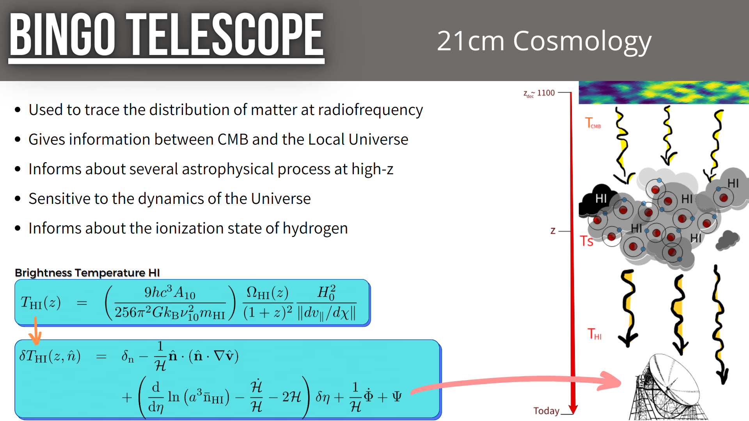
21 cm Cosmology: Motivation and Methods

Slide 24
Intensity Mapping
No Search for particular emission
Search instead for general Hydrogen emission
Large clouds

Slide 25
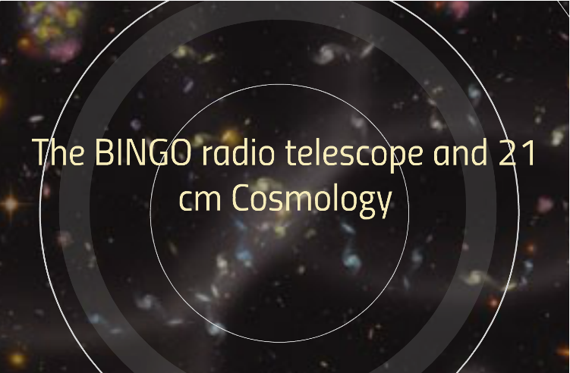

Slide 26
The Instrument
Two dishes (40 and 39 meters)
28 Horns (1.8 m wide, 4.8 m long)
System Temperature 70 K (can we reach 50K or even less?)
Simple off the shelf electronics in phase 1
Phased arrays in Abdus Project
Site at “Serra do Urubu” (Vulture heights) in Paraíba, Brazil

Slide 27
The Site

Slide 28
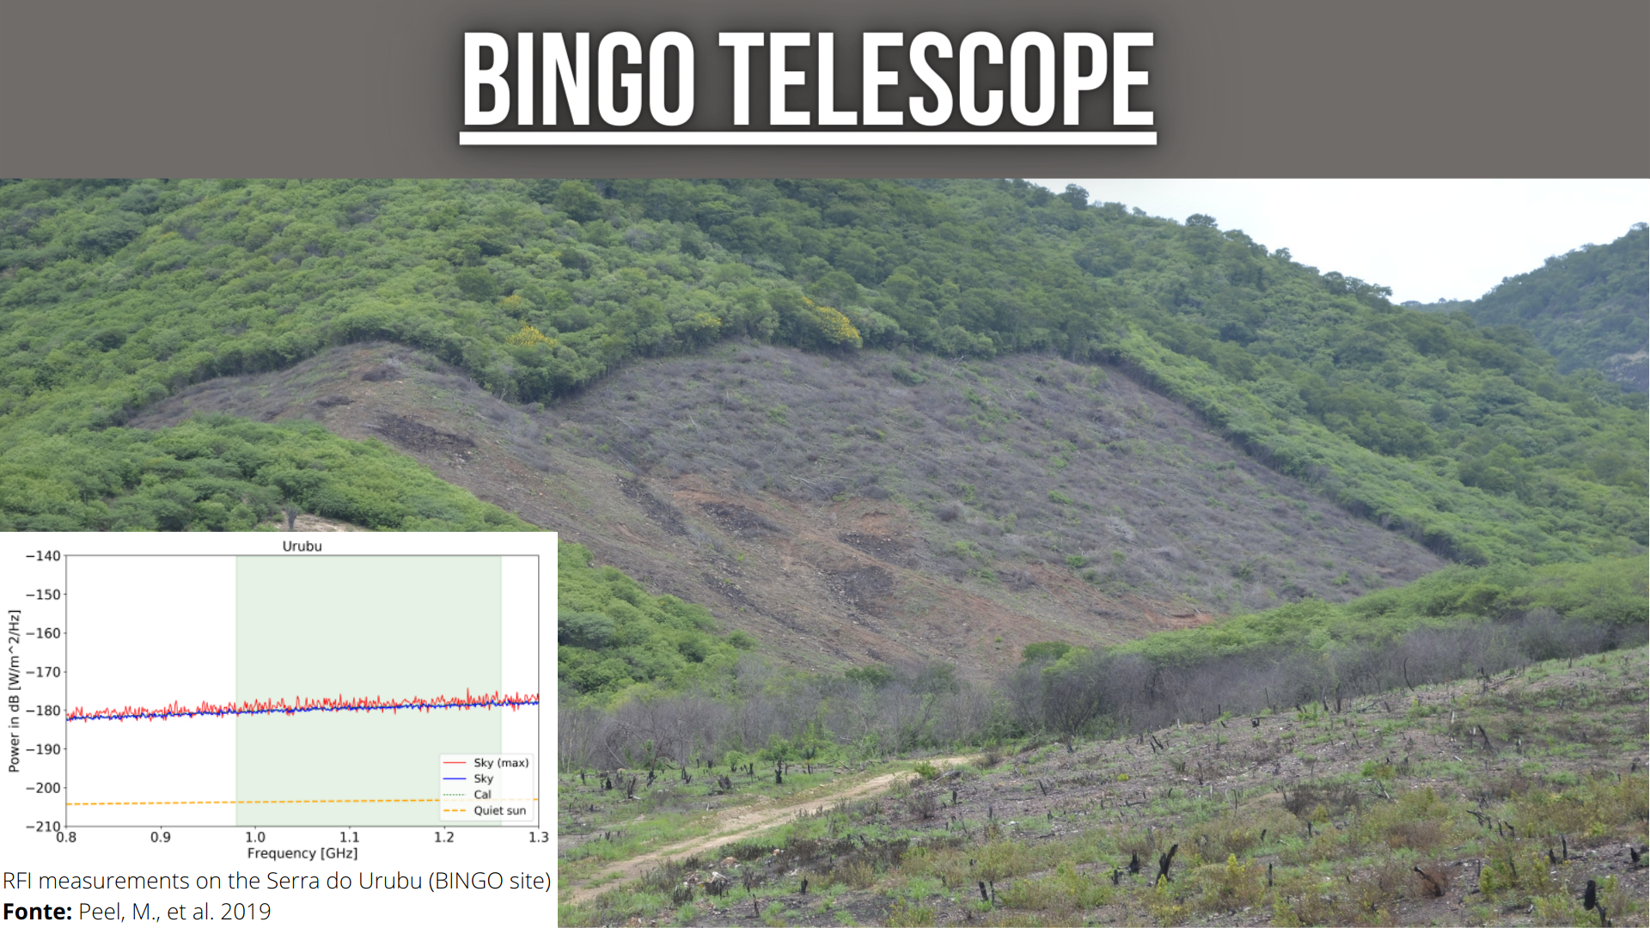
The Site
Clean sites in South America

Slide 29
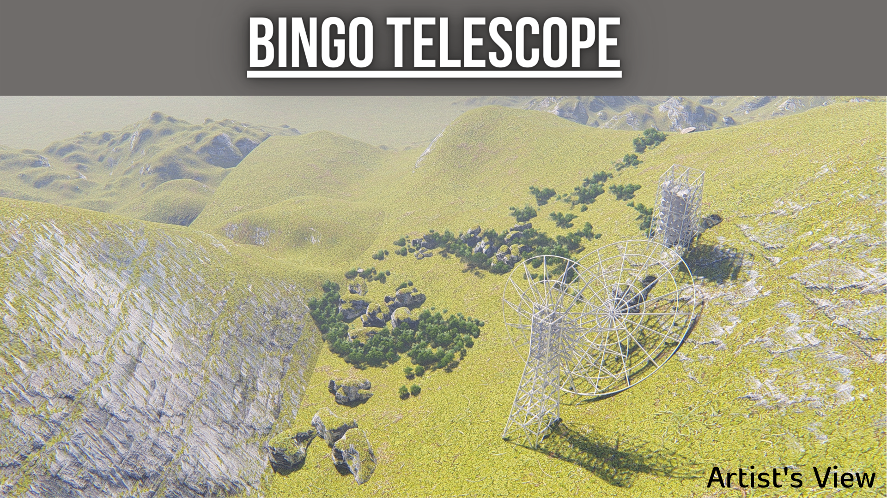

Slide 30
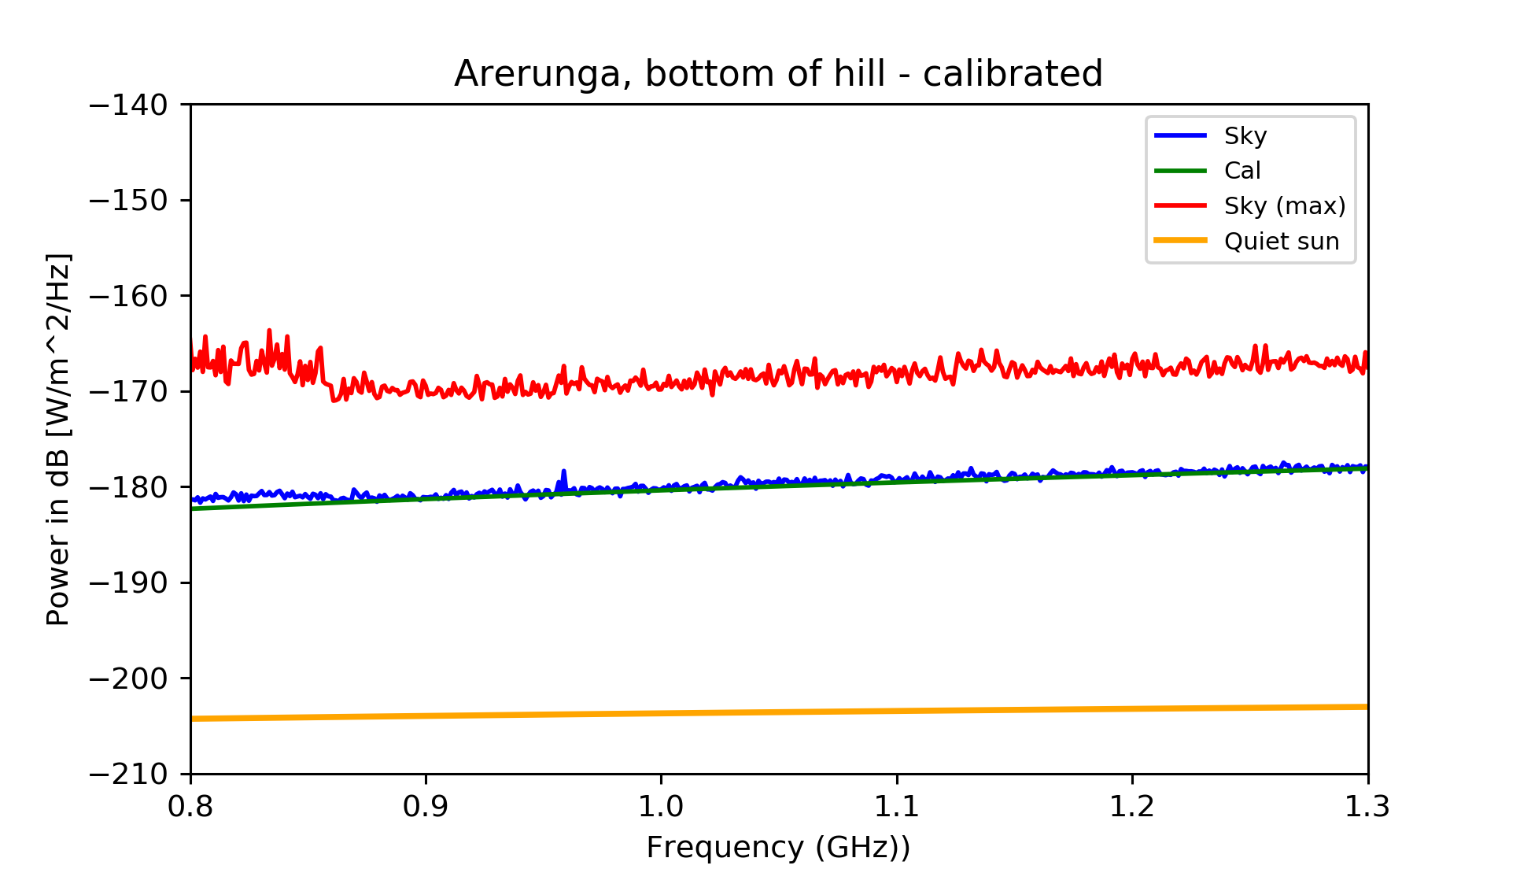
Uruguay

Slide 31
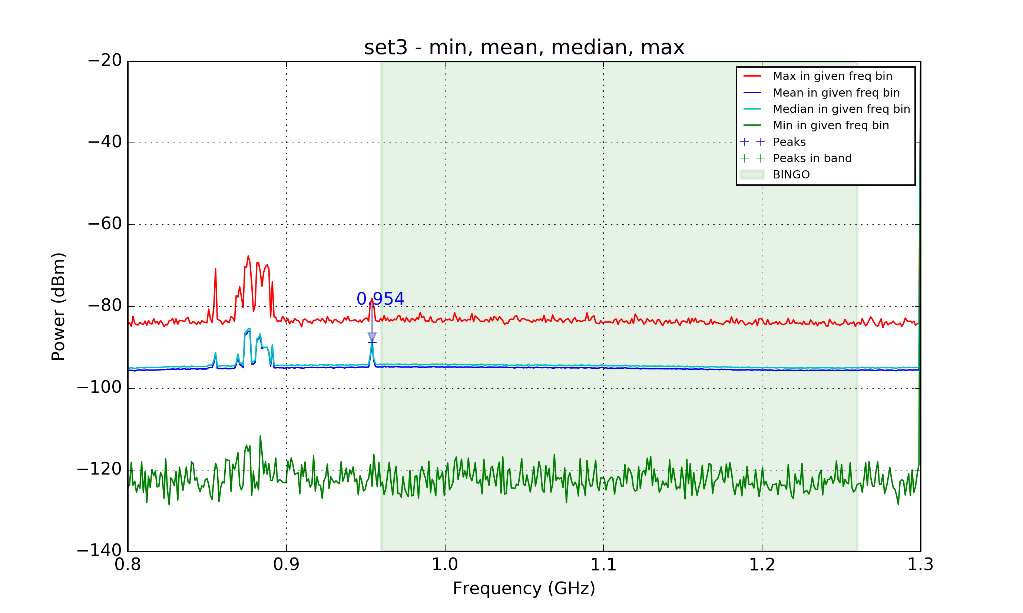
Cachoeira Paulista (SP)

Slide 32
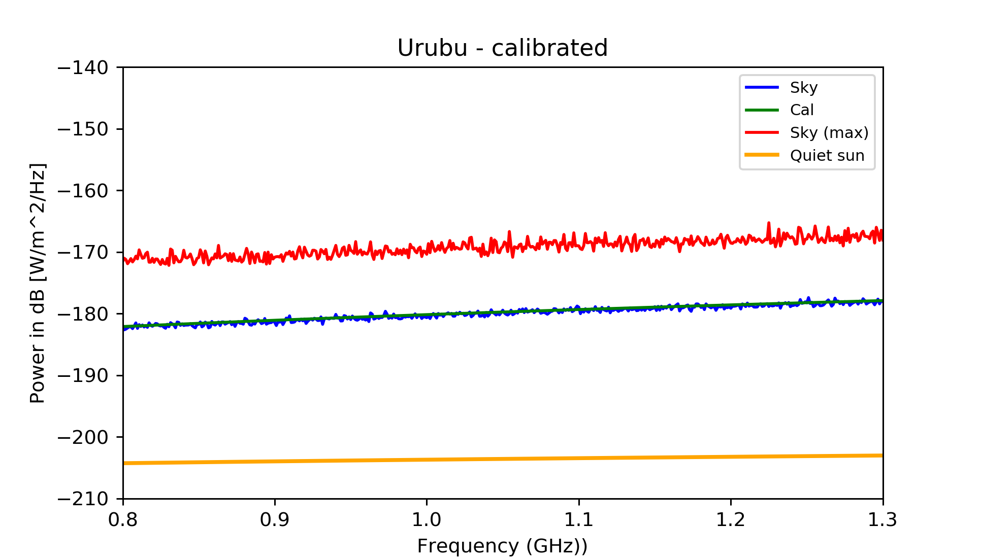
Urubu (Vulture heights), Paraíba

Slide 33
Motivations for BINGO
HI intensity mapping to measure BAO
Structure formation
Dark Sector properties (last half history of the Universe)
Static telescope, excellent for looking after transient phenomena
Fast astrophysical phenomena:
Pulsar properties
Fast Radio Bursts

Slide 34
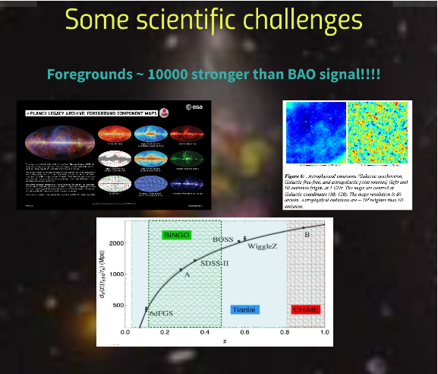

Slide 35
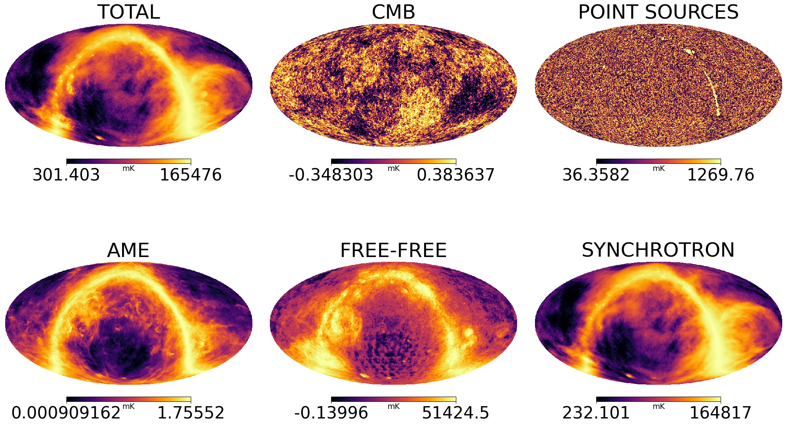

Slide 36
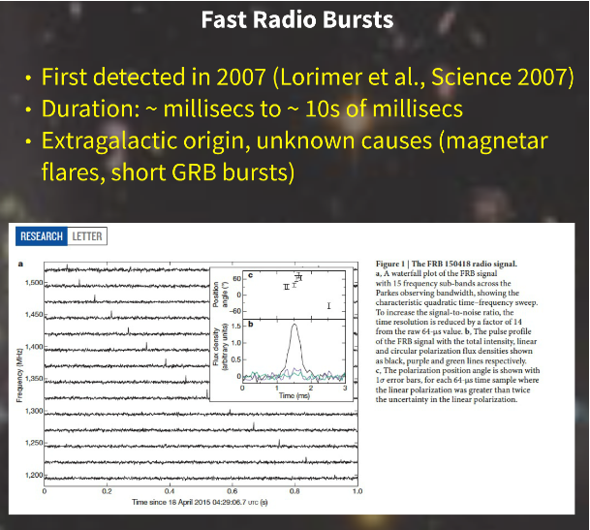

Slide 37
The various stages

Slide 38
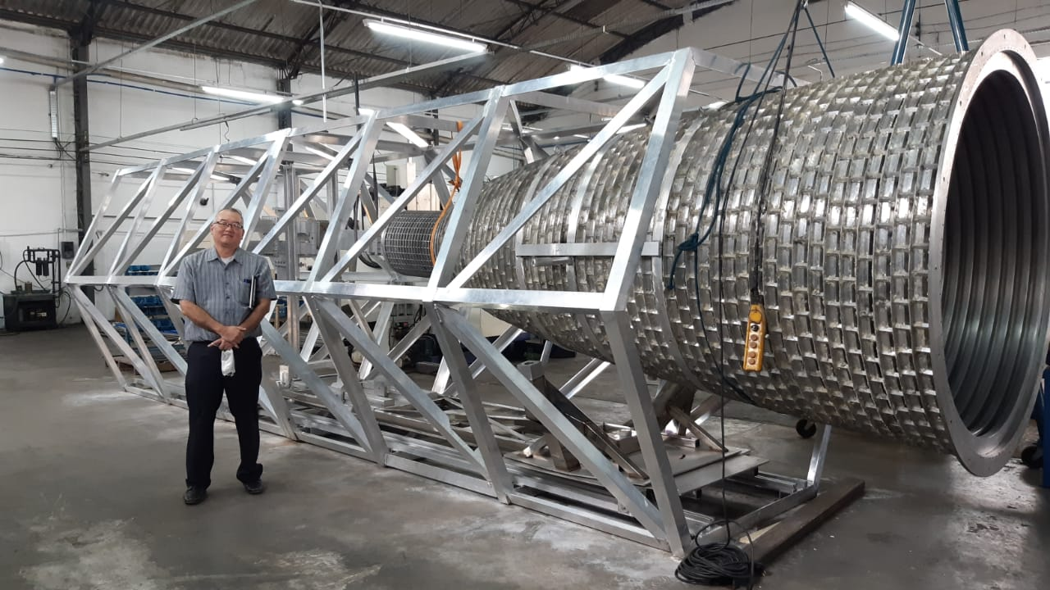
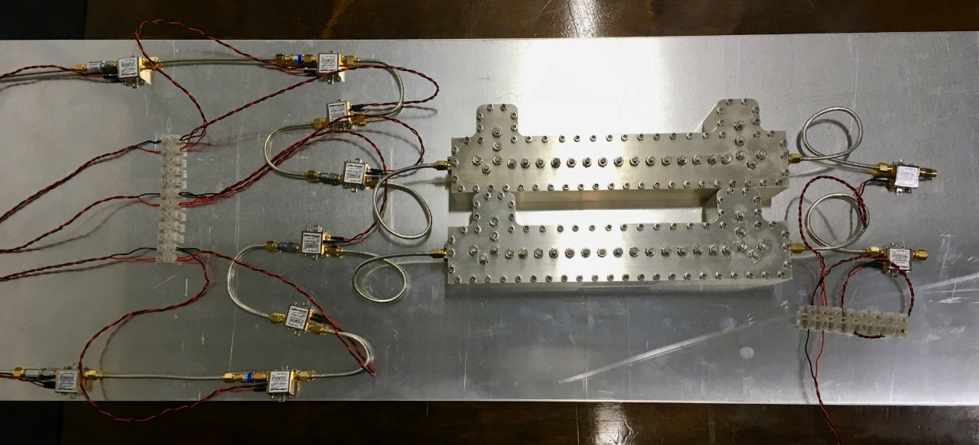
Stage 0
The Instrument:
Horns (basically done)
Receiver (already projected, now in series)

Slide 39
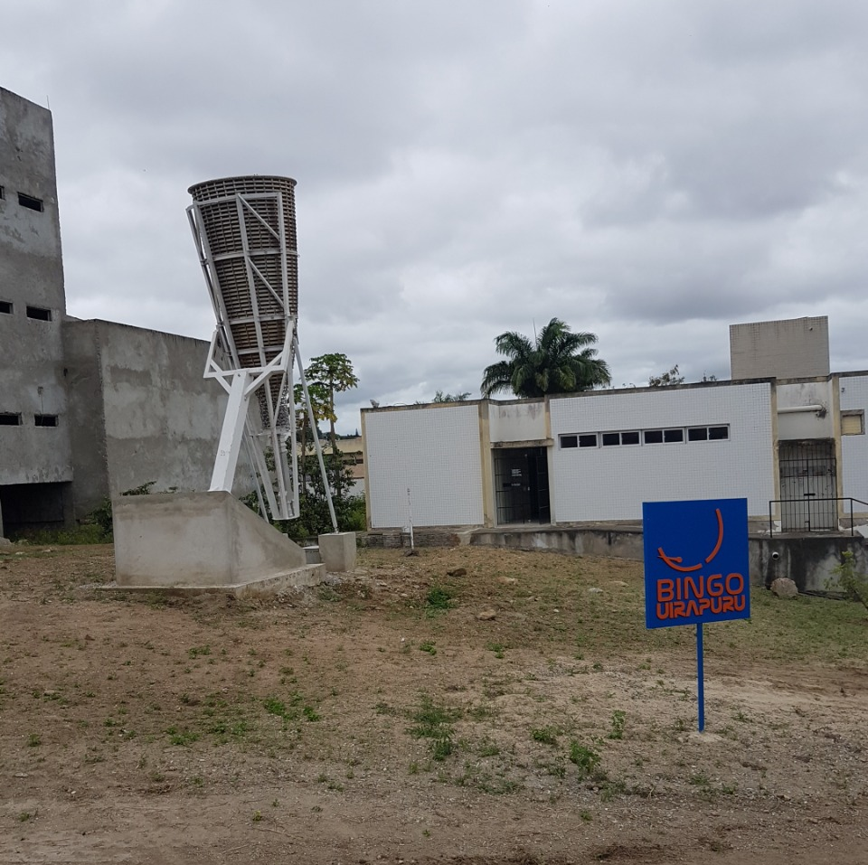
Stage 1
Raw data
FRB´s
Outriggers (Uiapuru in Campina Grande University campus, Paraiba)

Slide 40
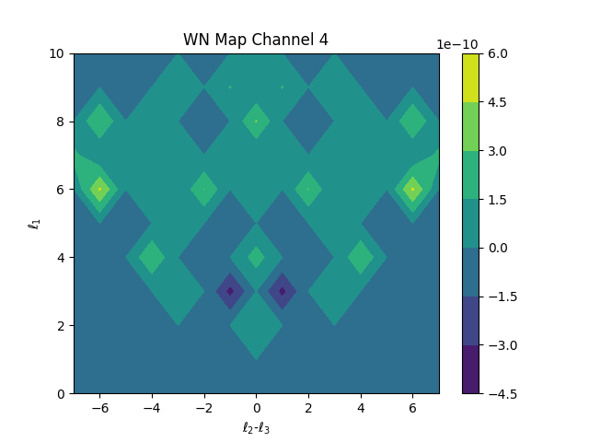
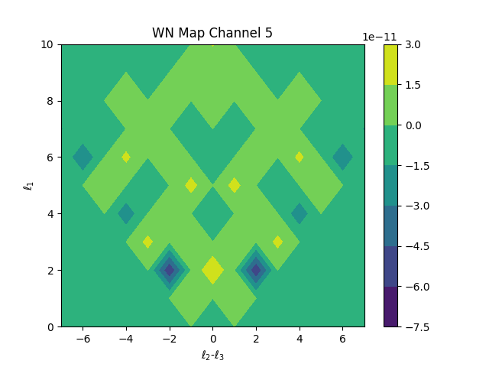
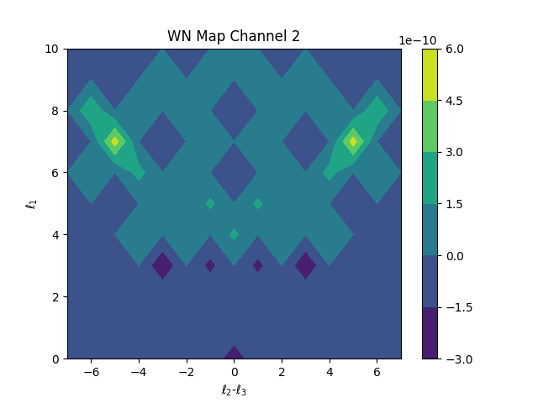
Stage 2
Component Separation
Noise analysis
Bispectrum

Slide 41
Stage 3
Mocks

Slide 42
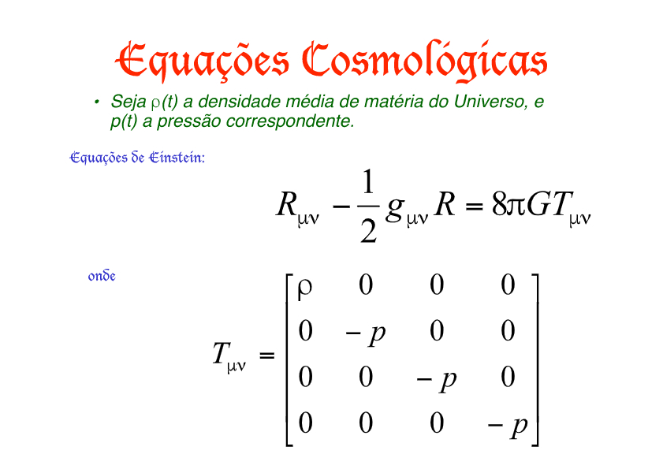
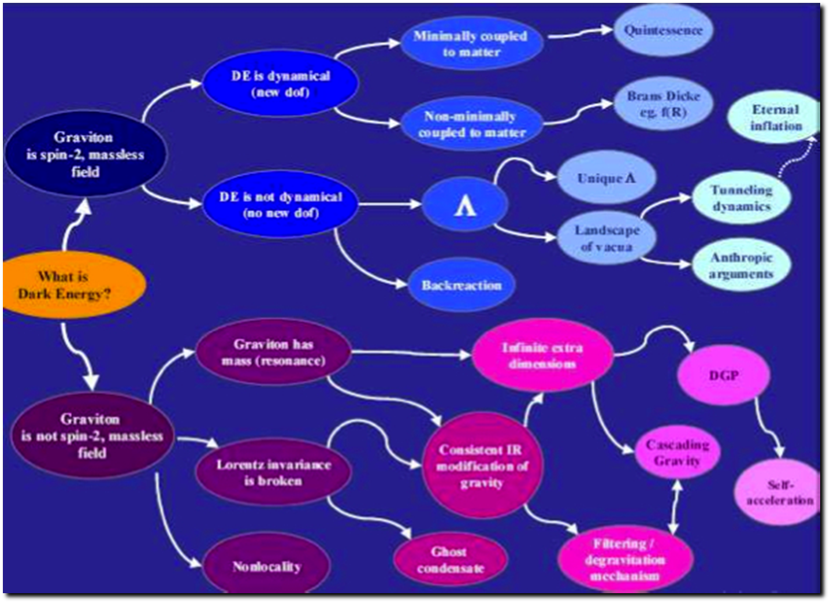
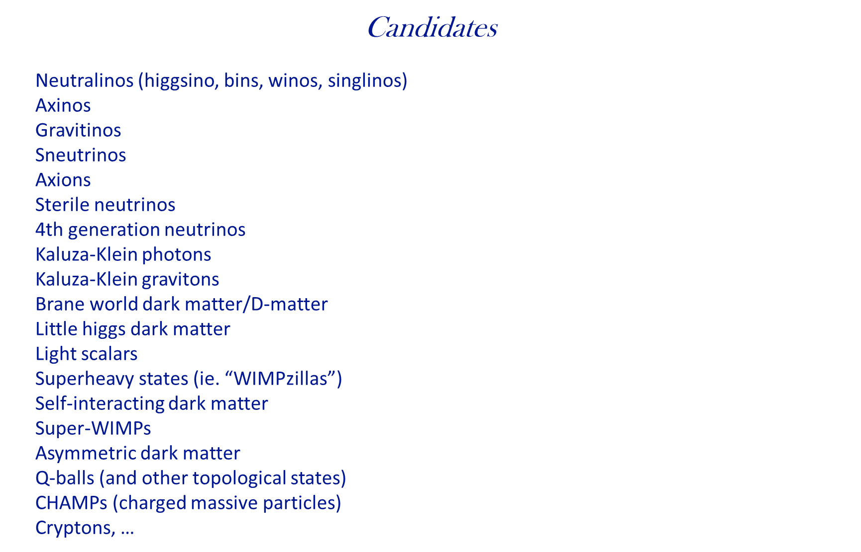
Stage 4
Theory

Slide 43
Theory
Structure of Dark Sector
cosmological parameters
DE/DM interactions
Models of DM/DE
FRB´s and cosmological parameters/consequences
Mass distribution
Pulsars
Flaring stars
Astrophysical signs and consequences
..............................

Slide 44
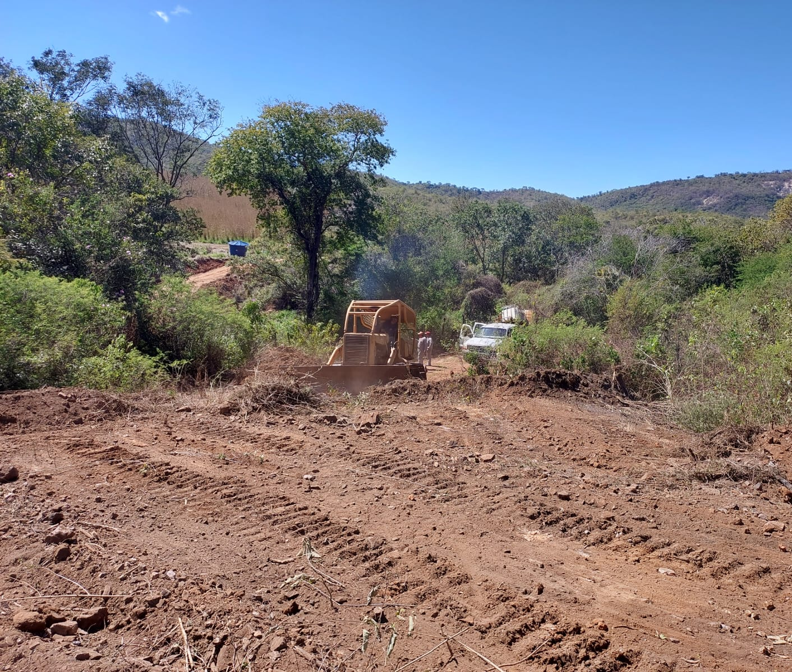


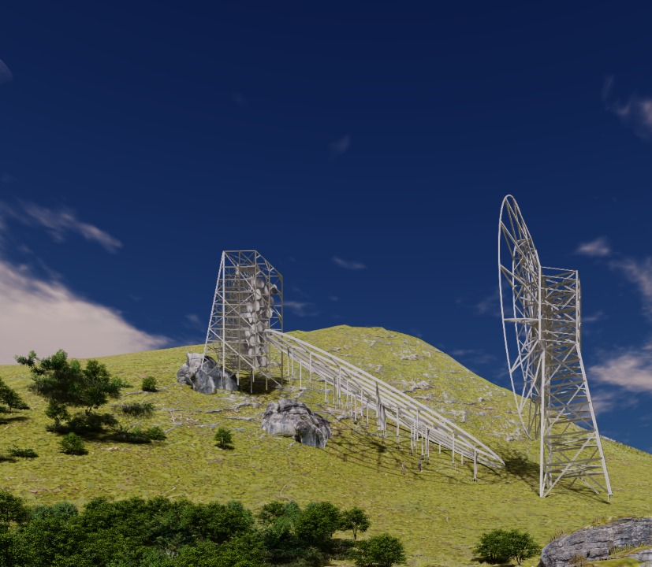
Construction
Ongoing construction operations

Slide 45
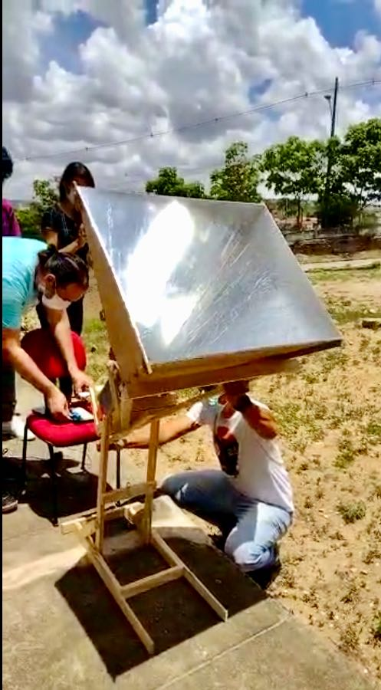
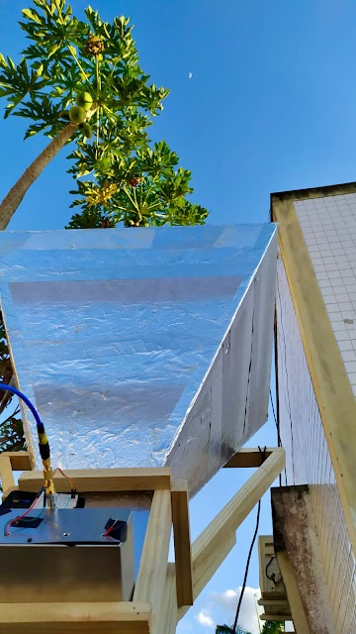
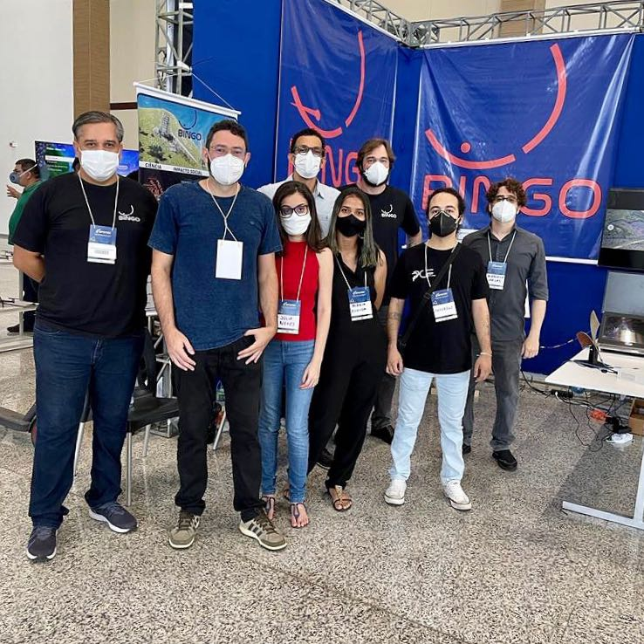
Outreach and education

Slide 46
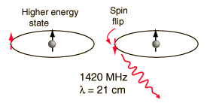
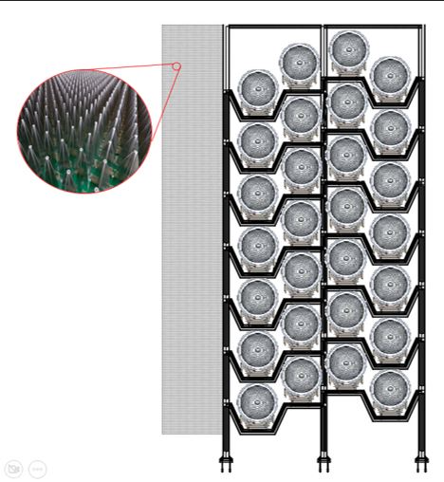
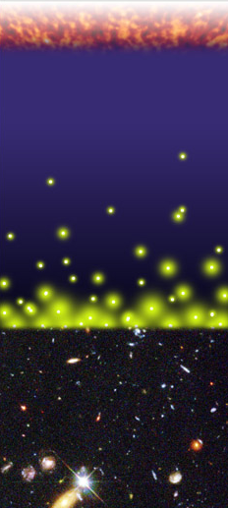
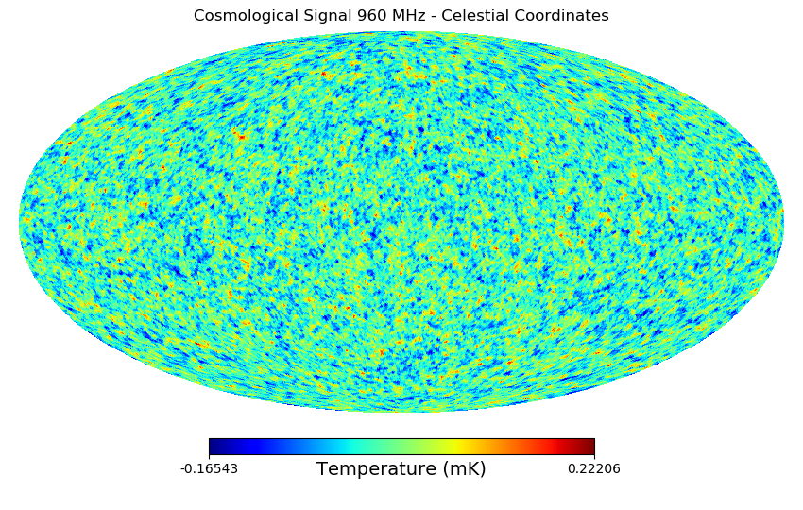
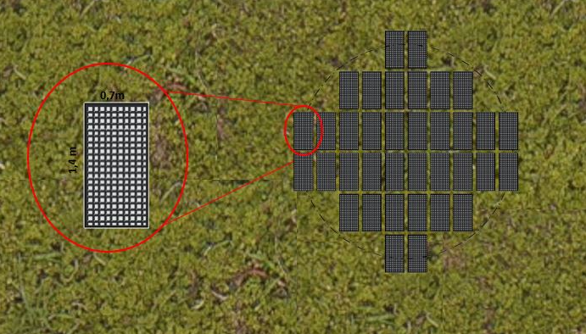
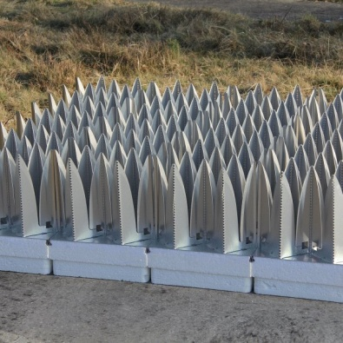

BINGO High Resolution the abdus project
Filipe Abdalla, Amilcar Queiroz, Elcio Abdalla, Bin Wang
450 – 1450 MHz
(z ~ 0 – 2.1)
1 MHz resolution
1.2 deg Resolution
T system 40K
Station 4500 m²
- What is the nature of dark energy?
- Can we measure the fluctuations with 21cm radiation
- Is our model of cosmology correct?

Slide 47
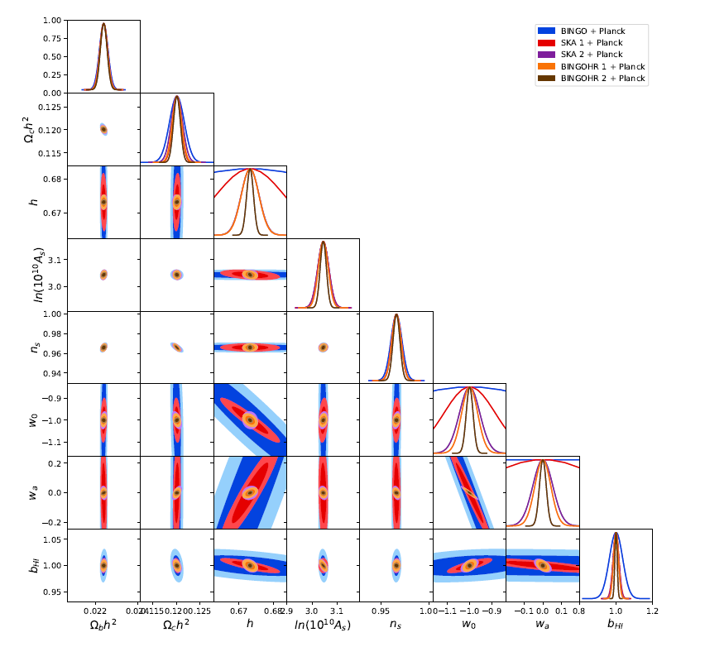
abdus forecasts
Can be competitive with even the largest surveys such as the Square Kilometre array.
Can also do other ancillary science extremely well such as finding the elusive FRBs.

Slide 48
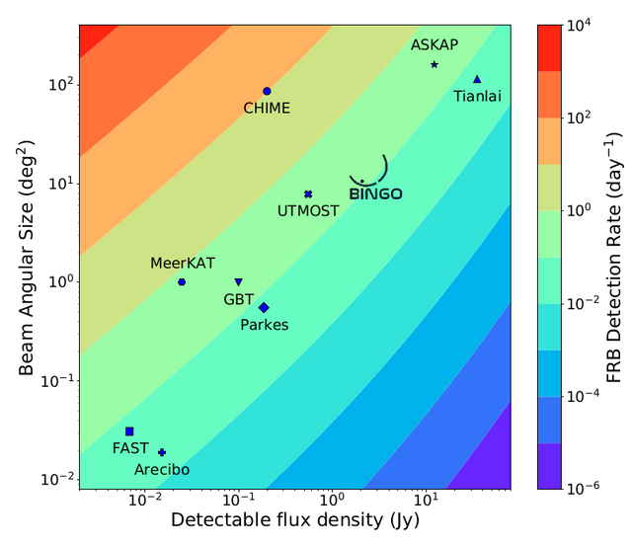
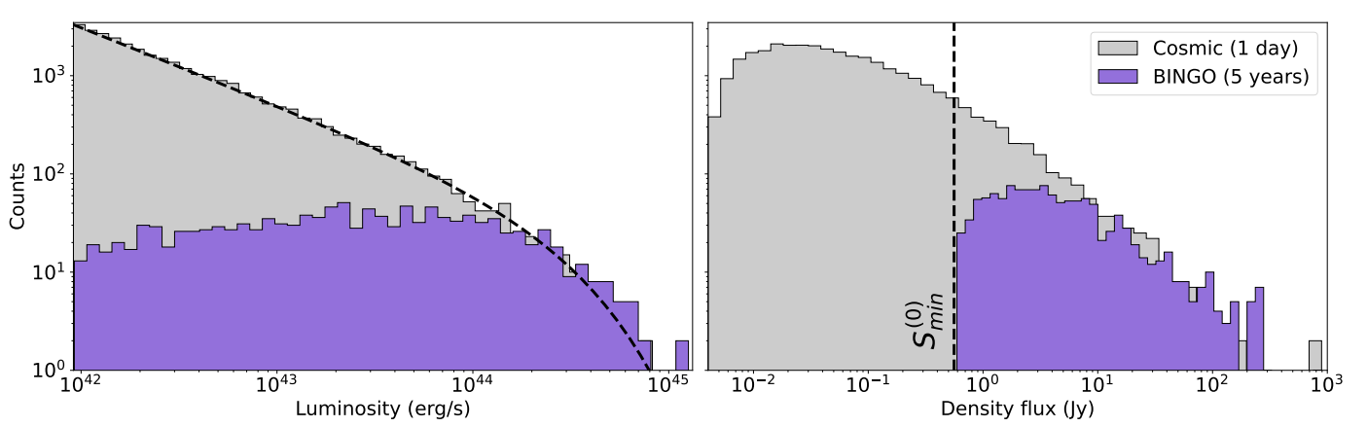
Search for FRBs with BINGO main
Several FRBs will be found, competitive with CHIMES, but no localization is possible with the main telescope only.

Slide 49
ABDUS and phased array antennas
Phased arrays consist of closely distributed antenna elements, allowing synthesis of multiple independent beams.
ABDUS proposes the use of phased arrays to boost BINGO's capabilities.
ABDUS-1 involves associating phased arrays with the BINGO focal plane using Vivaldi antennas and beamformers.
ABDUS-2 includes outriggers composed of feed horns and phased-array stations 20 km away to achieve higher angular resolution.

Slide 50
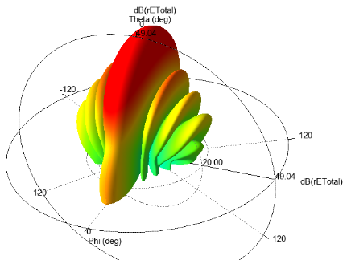
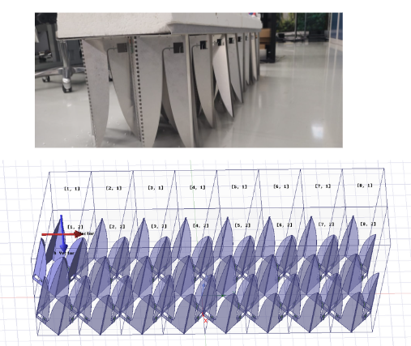
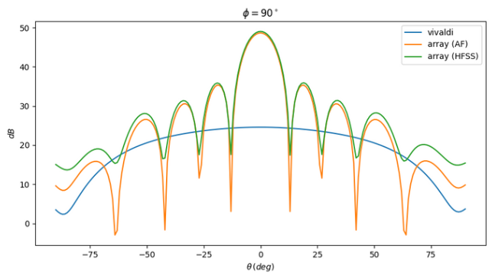
Vivaldi Tile simulation
We simulated a 2x8 array. It correspond to a 35cm x 134 cm tile that will be used on ABDUS project.
The tile is also under tests on ASTRON facilities and will be sent to Brazil after some measurements be finished.

Slide 51

Localização do BINGO: Coords: 7° 2' 27.6” S; 38° 16' 4.8" W
Paraíba state
8

Slide 52



Slide 53
Support
FAPESP (Fundação de Amparo à Pesquisa do Estado de São Paulo)
Paraiba Government (João Azevedo, Claudio Furtado, Rubens Freire) *
FINEP (Projects and Studies financing – Federal Government)
Ministry of Science and Tecnology (Brazil)
Federal University of Campina Grande
University of São Paulo
National Natural Science Foundation of China
YangZhou University (China)
INPE (National Institute of Space Research, Brazil)

Slide 54




Main Collaborating Companies
Alltec (São Paulo): metallurgy/horns
CETC 54 (China): metal structure
IBRTEL (Paraiba): construction
Ponto de Apoio and GTP (projects)

Slide 55


Slide 56
Inauguration and begining of commissioning
Between November 2024 and February 2025
Thanks for the attention

